Slide 1
Hari Singh Nalwa

Slide 2
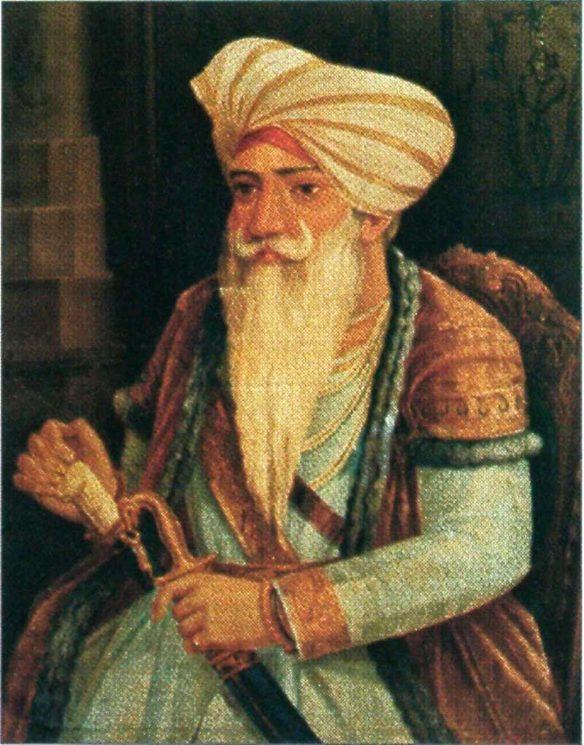
Commander-in-chief at the most turbulent North West Frontier of Maharajah Ranjit Singh’s Kingdom
He took the frontier of the Sarkar-e-Khalsa (The name of the Sikh Empire) to the very mouth of the Khyber Pass

Slide 3
A 19th century British newspaper, Tit-Bits…article quote.. Some people might think that Napoleon was a great General. Some might name…………<snip>… But let me tell you that in the North of India a General of the name of Hari Singh Nalwa of the Sikhs prevailed. Had he lived longer and had the sources and artillery of the British, he would have conquered most of Asia and Europe…." Link

Slide 4
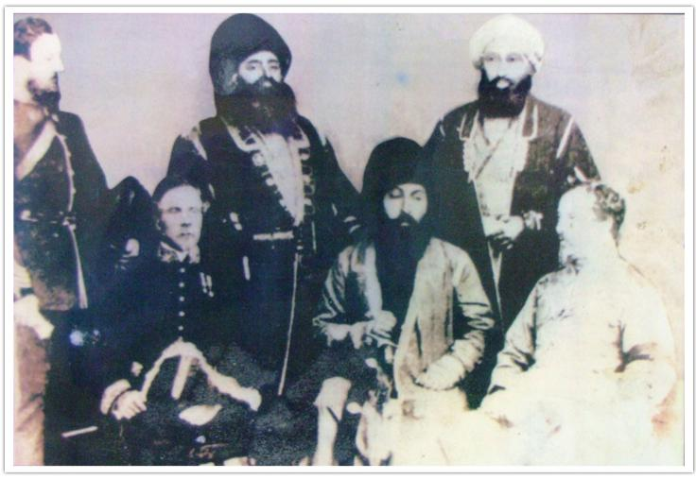
Hari Singh Nalwa with Maharaja Ranjit Singh

Slide 5
Australian Website Link
http://www.billionairesaustralia.com/10-greatest-conquerors-history-world/

